Slide 1

Introduction to Machine Learning
Agenda
Definition
Types of Learning
Applications
Evaluation Metrics

Slide 2
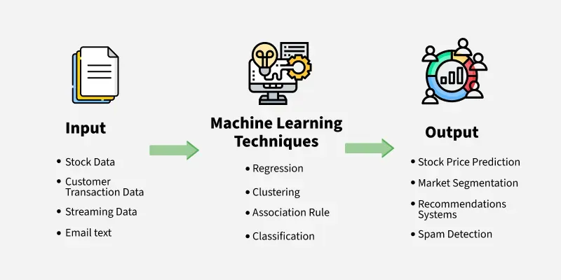
Introduction to Machine Learning
Definition: Machine Learning (ML) is a subset of AI that enables computers to learn patterns from data and make predictions or decisions without explicit programming.

Slide 3
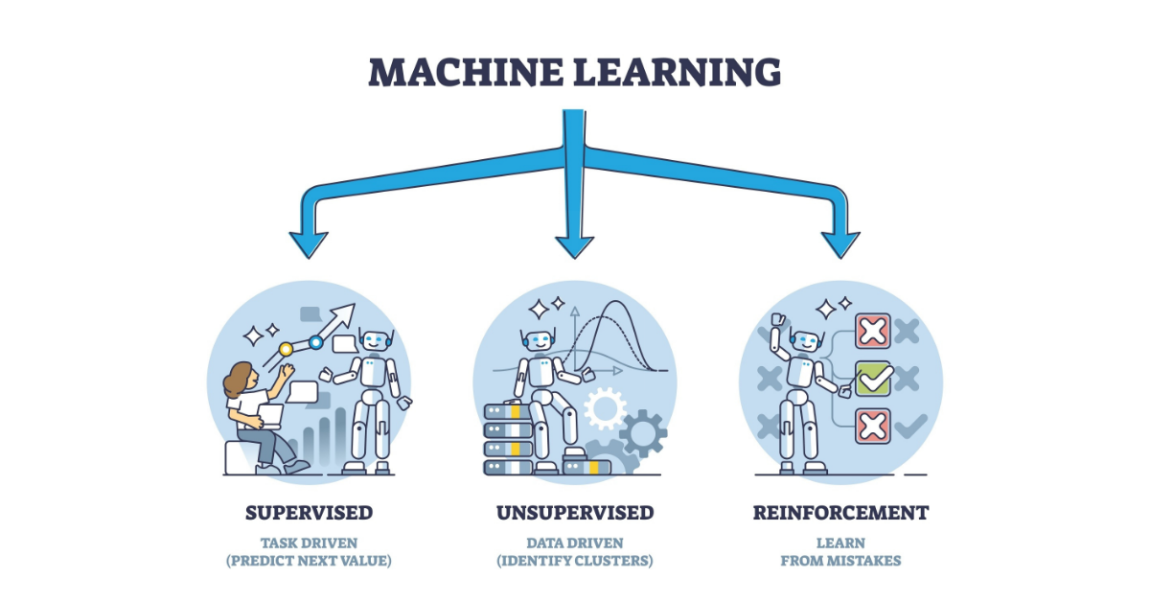
Types of Machine Learning

Slide 4
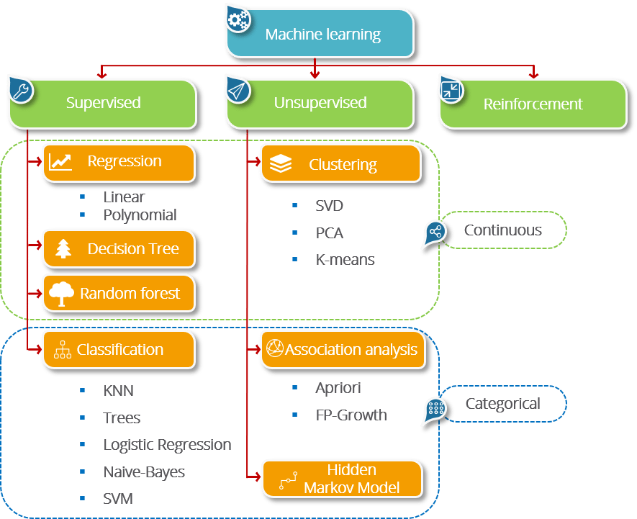
Types of Machine Learning

Slide 5
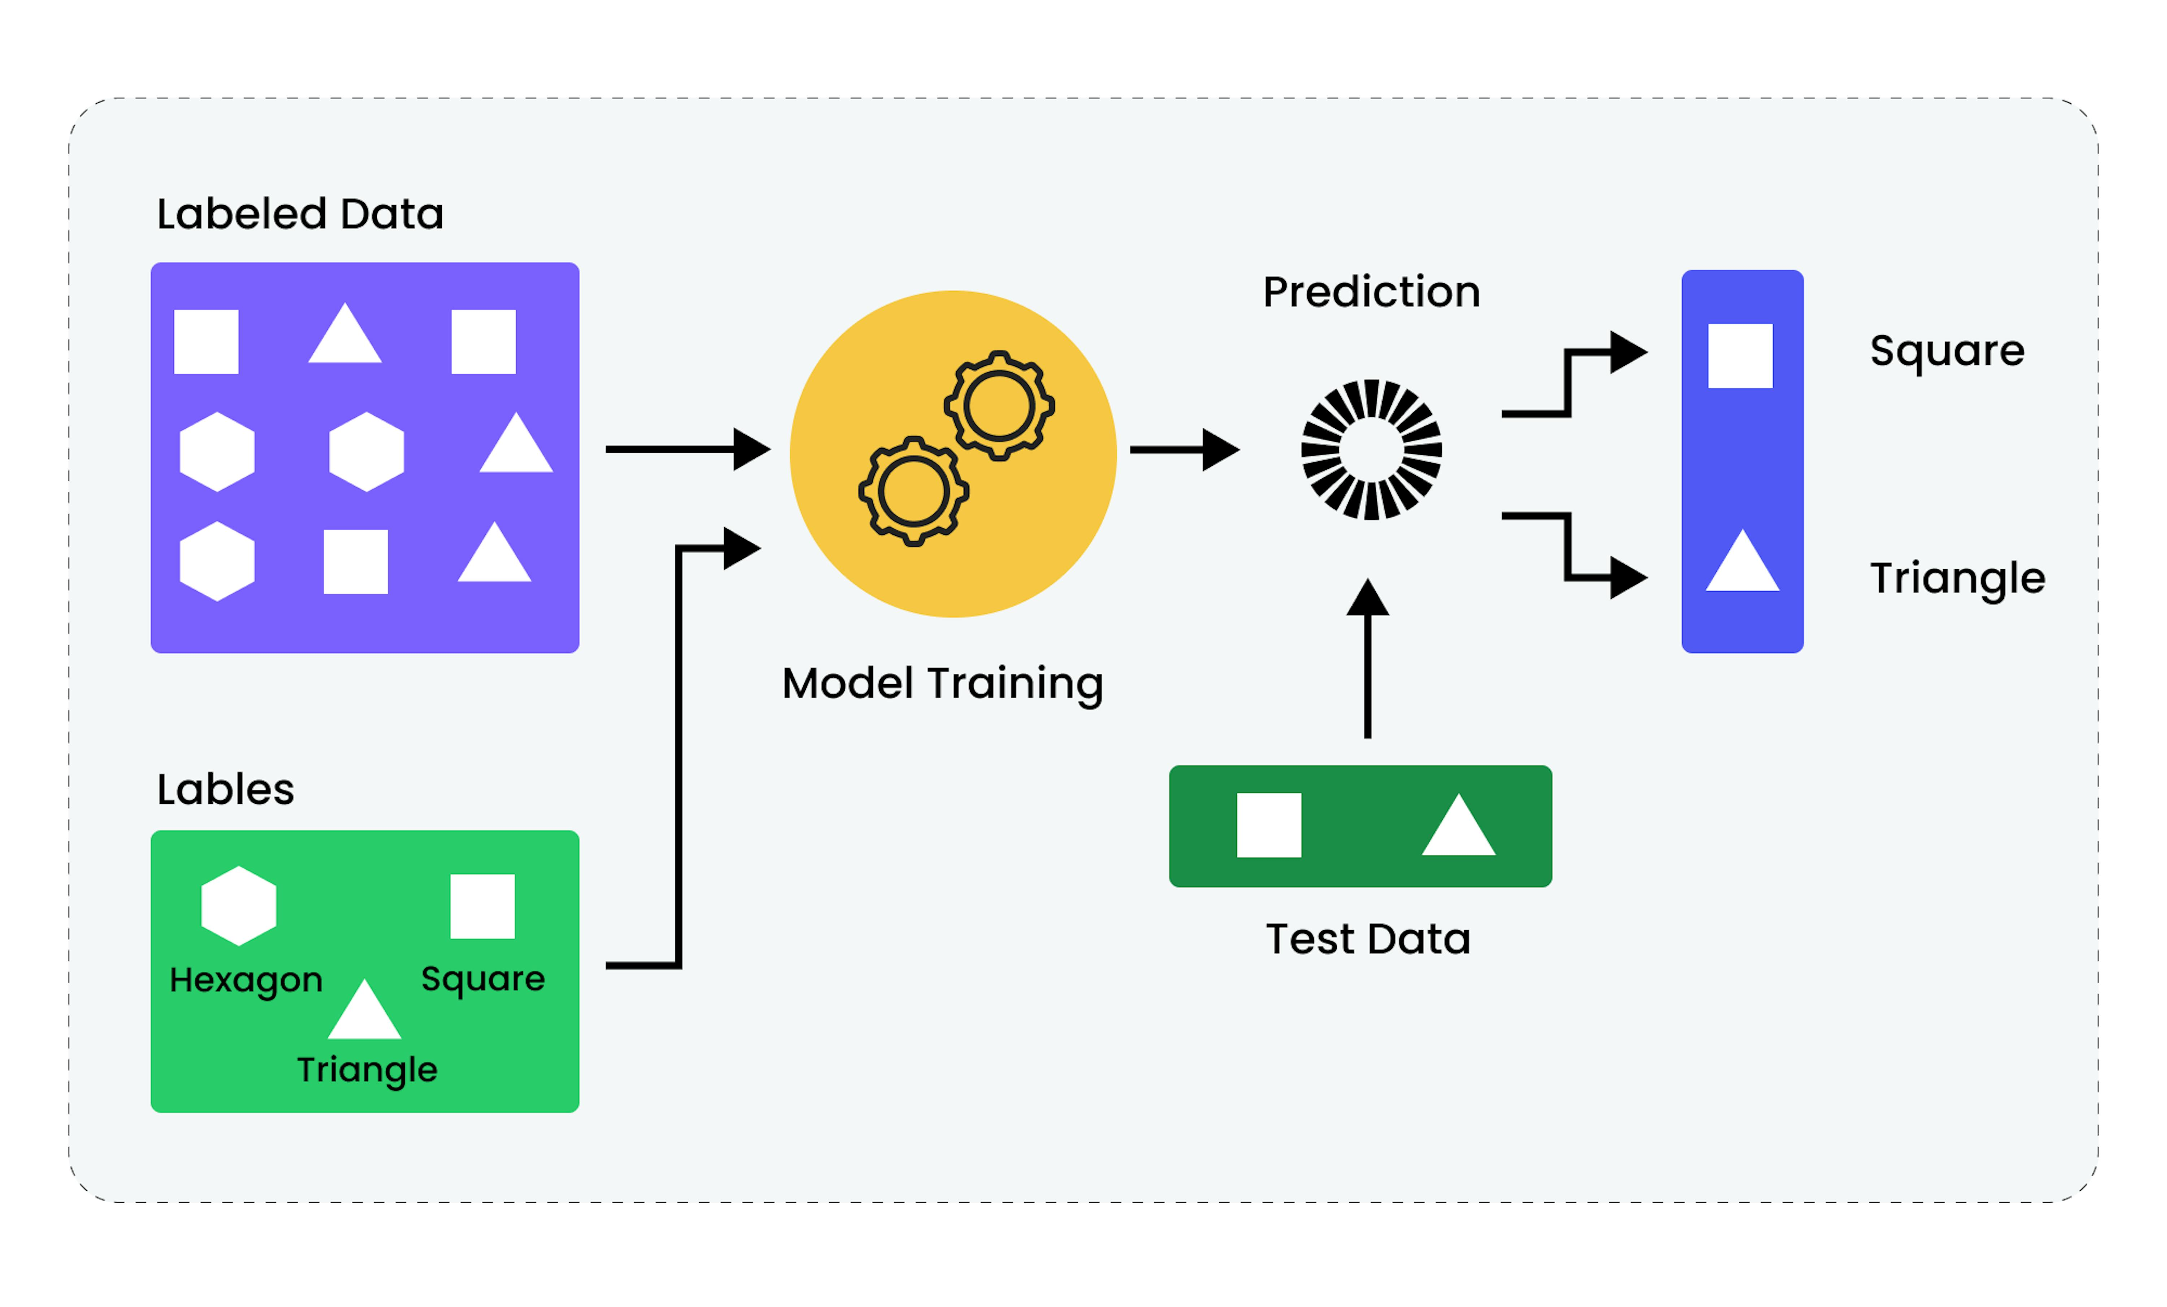
Supervised Learning
What is Supervised Learning?
Learning from labeled data
Examples: Email spam detection, medical diagnosis

Slide 6
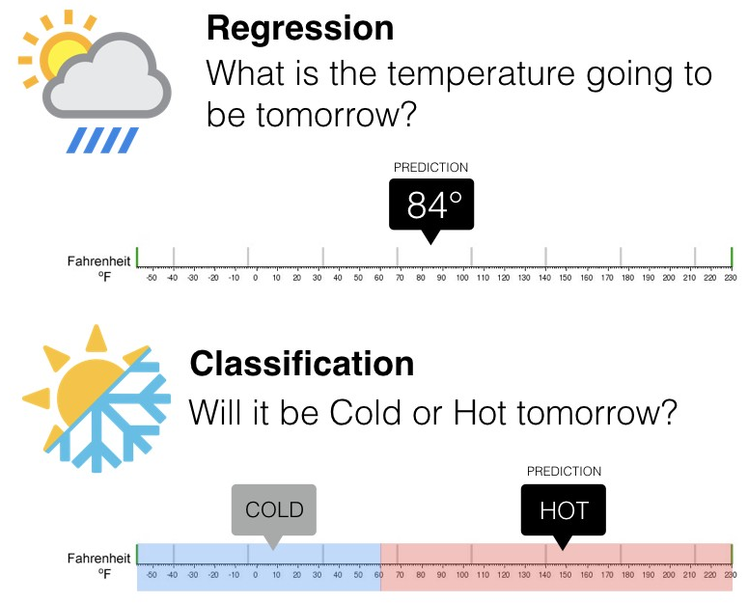
Supervised Learning Tasks

Slide 7
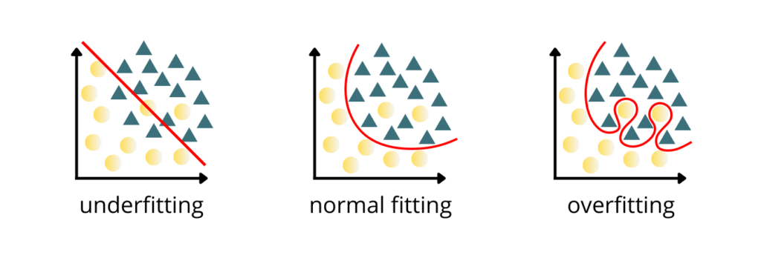
Overfitting in Supervised Learning
Definition: Model learns noise instead of pattern
Solution: Regularization, cross-validation

Slide 8
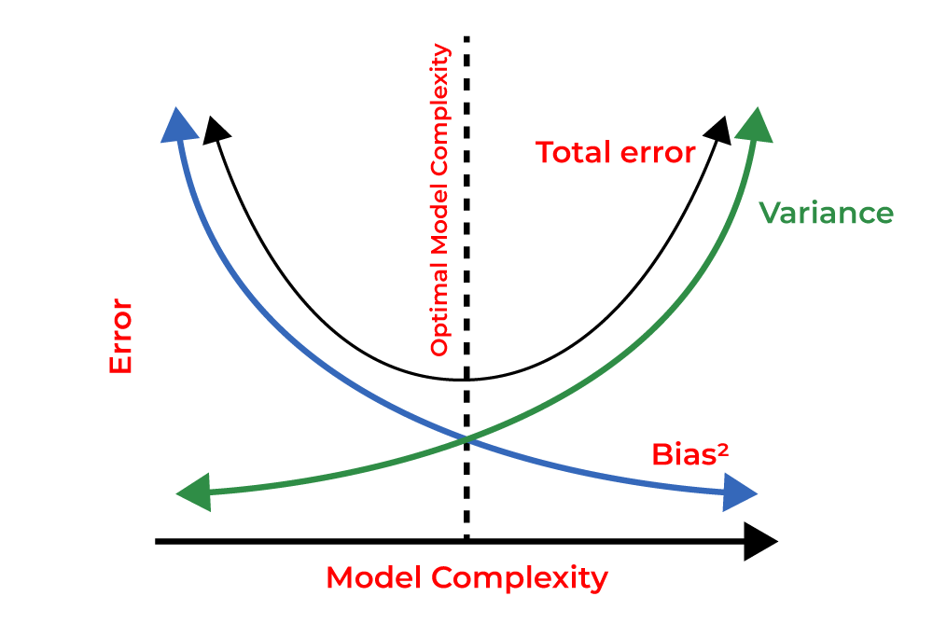
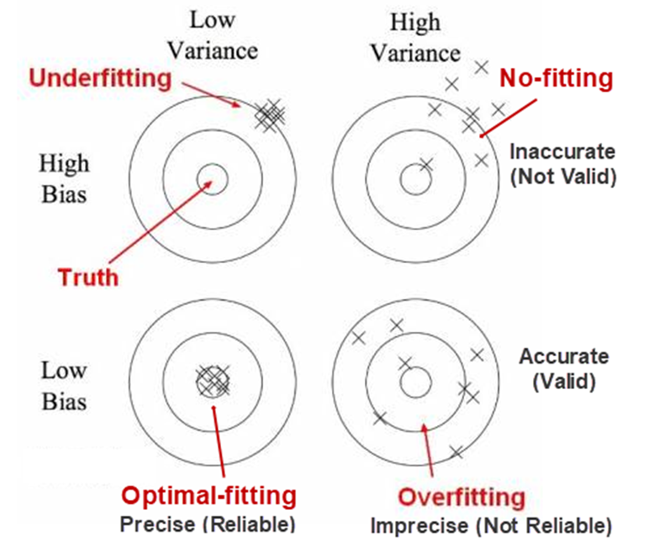
Bias-Variance Trade-off
Bias: Error due to overly simplistic models
Variance: Error due to overly complex models
Trade-off: Balancing both for optimal performance

Slide 9
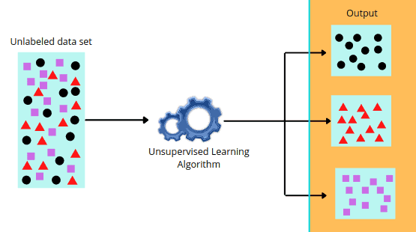
Unsupervised Learning
What is Unsupervised Learning?
Learning from unlabeled data
Examples: Customer segmentation, anomaly detection

Slide 10
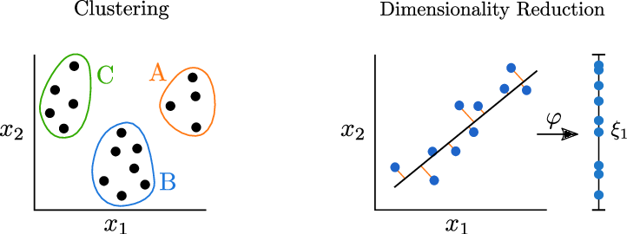
Unsupervised Learning Tasks

Slide 11
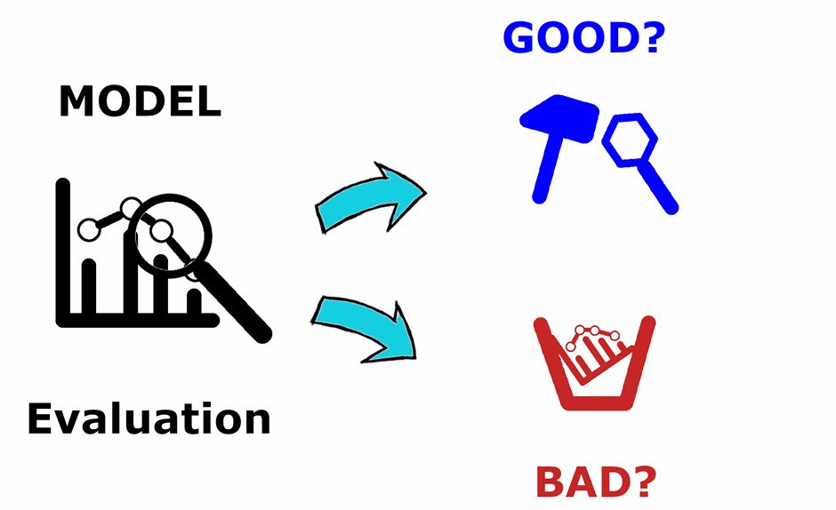
Why Evaluation is Important?
Helps assess the performance of ML models

Slide 12
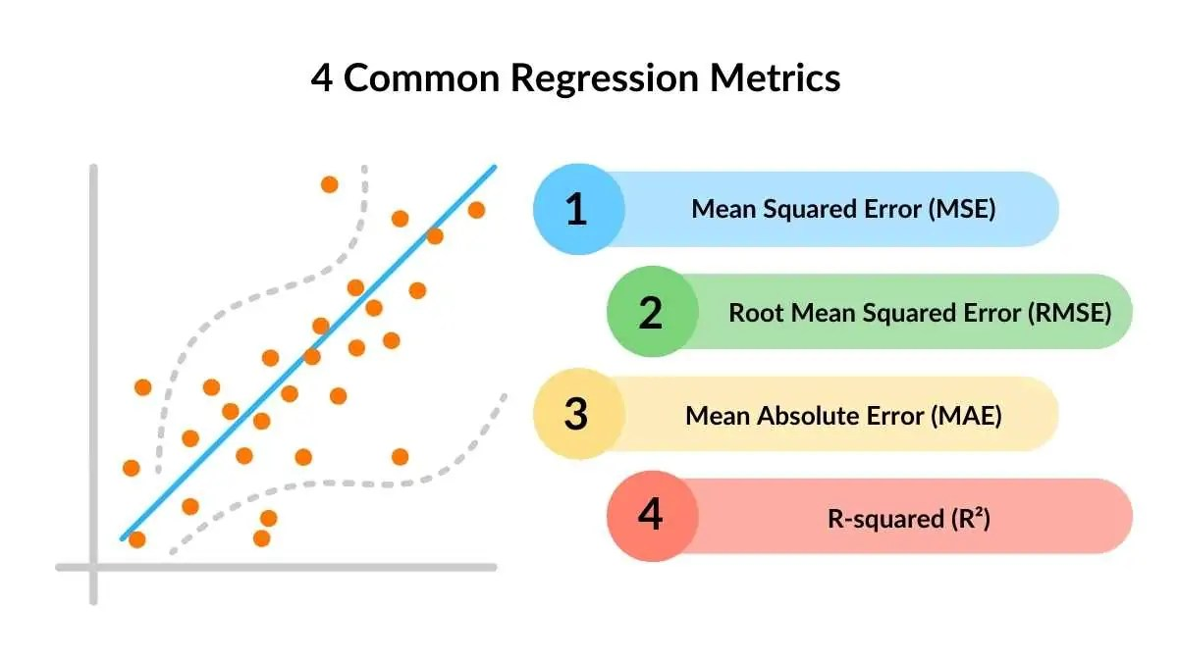
Regression Metrics
MSE Measures average squared error
RMSE Square root of MSE (same unit as target)
MAE Measures average absolute error
R-squared (R²) - Coefficient of Determination : Measures goodness of fit (closer to 1 = better)

Slide 13
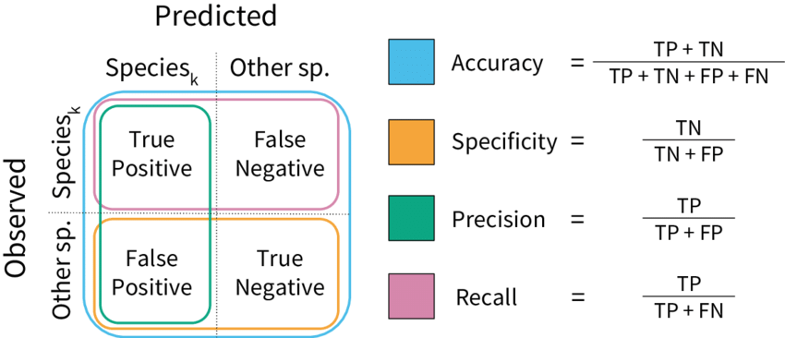
Classification Metrics
Accuracy = (Correct Predictions / Total Predictions)
Precision = (True Positives / (True Positives + False Positives))
Recall = (True Positives / (True Positives + False Negatives))
F1-Score = 2 × (Precision × Recall) / (Precision + Recall)

Slide 14
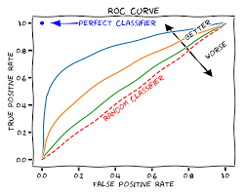
ROC Curve & AUC
ROC Curve: Trade-off between True Positive Rate (TPR) & False Positive Rate (FPR)
AUC (Area Under Curve): Higher AUC = Better model

Slide 15

Applications of Machine Learning

Slide 16
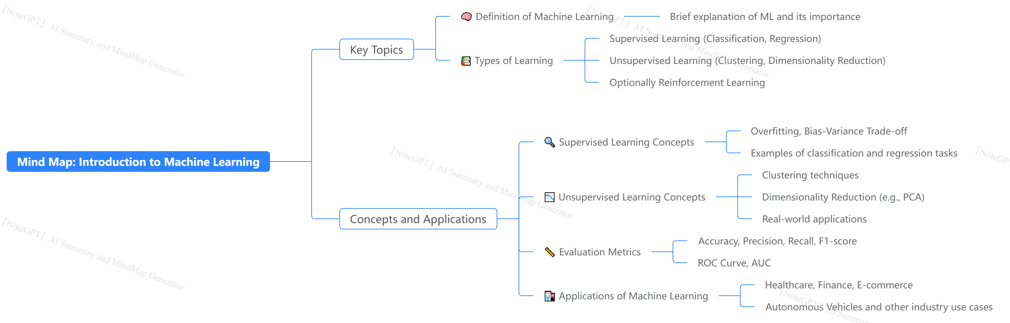
Learning Outcome

Slide 17
Thank You

